Slide 1

CENG 334 – Operating Systems
01- Introduction
Assoc. Prof. Yusuf Sahillioğlu
Computer Eng. Dept, , Turkey

Slide 2
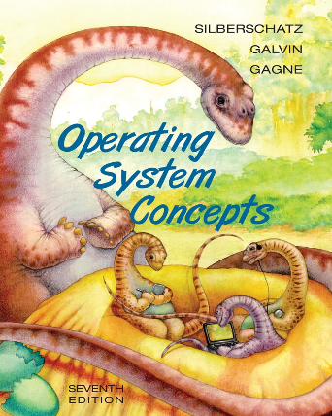
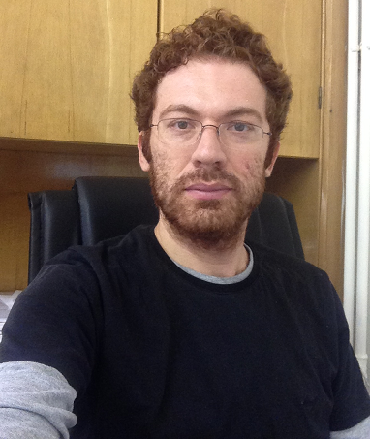
Administrative
<number> / 23
Tue 10:40 & 16:40 @ BMB-2 and Thu 16:40 @ BMB-3
www.ceng.metu.edu.tr/course/ceng334/ //official
www.ceng.metu.edu.tr/~ys/ceng334-os/ //my lecture slides
Grading
  42%: 2 Midterm Exams, 21% each.
  22%: Final Exam.
  36%: 3 Assignments, 12% each.
Textbook: Operating System Concepts:
Textbook slides and Dr. Sahin and Korpeoglu’s slides are occasionally used.
Instructor: Yusuf Sahillioğlu (ys@ceng.metu.edu.tr)
(office: B107)

Slide 3
About the Course
<number> / 23
Learn
  Concepts and components of OSs.
Code
  3 programming assignments in C.
Case study
  Linux.

Slide 4
What’s an Operating System?
<number> / 23
A program that acts as an intermediary between a user of a computer(ized device) and the computer(ized device) hardware.
Objectives
  Abstraction – Hides details of different hardware configurations.
    Develop programs easier.
  Arbitration – Manages access to shared hardware resources.
    Execute user programs and use computer hw efficiently.
Notes:
Computerized device: Microwave, printer, digital clock, iPhone, ATM, etc.

Slide 5




Abstraction
<number> / 23
Apps do not have to be tailored for each possible device in the system.
App: FM
App: FM
Computer1: Dell
Computer2: Acer
Notes:
No OS: App developer had to write different codes for different hardwares; and user would have to select his hw while installing (to install the correct code) ☹

Slide 6


Abstraction
<number> / 23
Apps do not have to be tailored for each possible device in the system.
App: FM
App: FM
OS
OS
Computer1: Dell
Computer2: Acer
Notes:
Yes OS: Since OS knows how to communicate (e.g., request memory, send CPU instructions, use graphics card) with multiple forms of HW, app developer just needs to communicate with the OS through this horizontal nice platform; hence app size gets smaller ☺

Slide 7

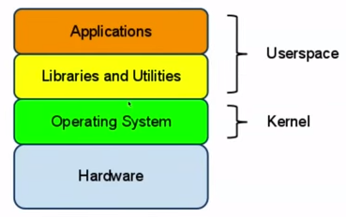
Abstraction
<number> / 23
Apps communicate with OS through Libraries; so we only have to code according to the API of the library in use, e.g., OpenGL, Qt, STL.
Notes:
One higher level of abstraction is between the user and the app. The user, e.g., an old lady, interacts with the app by clicking on the buttons, dragging sliders, or entering keyboard inputs.

Slide 8
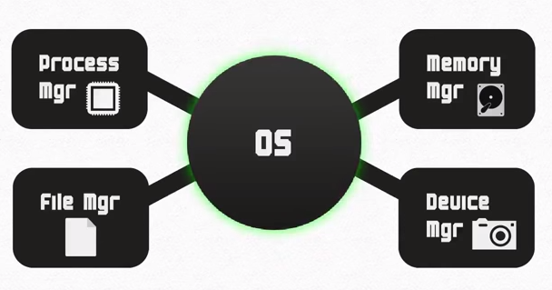
Arbitration
<number> / 23
Multiple apps share the same hardware resources simultaneously (use hw efficiently).
These managers of OS work together like a team to get jobs done.

Slide 9
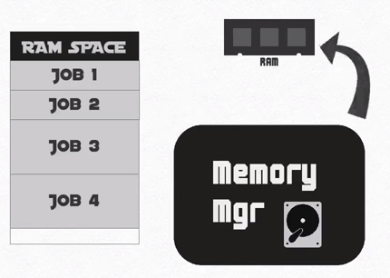
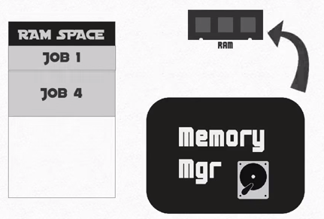
Arbitration
<number> / 23
Memory manager.
  Allows allocation and deallocation of memory space.
Notes:
Give every application the illusion of having infinite memory.

Slide 10
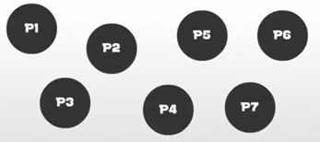
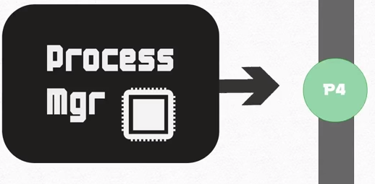
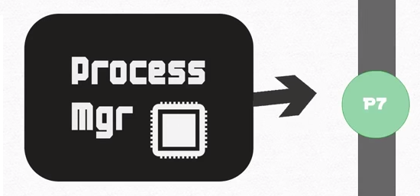
Arbitration
<number> / 23
Process manager.
  Decides how to allocate the brain of the computer, the CPU.
Notes:
Process manager keeps track of the status of each process; allows it to use CPU to get executed.
Give every application the illusion of having its own CPU, aka concurrency.
Concurrency is interleaving the execution order of the tasks and thereby creating an illusion of simultaneously executing, while parallelism is the physically simultaneous execution of (possibly related) computations. Concurrency is about dealing with lots of things at once (one processor, may benefit from multiples for speed up). Parallelism is about doing lots of things at once (requires multiple processors) (by reducing data dependencies).

Slide 11
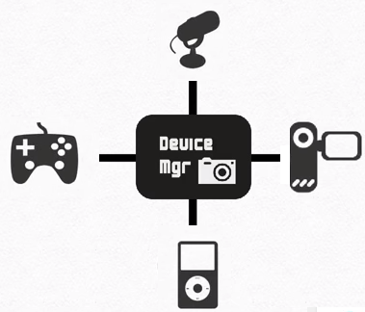
Arbitration
<number> / 23
Device manager.
  Monitors every device connected to the system.

Slide 12
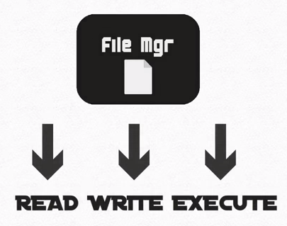
Arbitration
<number> / 23
File manager.
  Sets permissions so that certain users can only see certain files.
Notes:
Guest can’t see admin’s files.

Slide 13
Computer System Structure
<number> / 23
Hardware.
  CPU, memory, I/O devices.
Operating system.
  Controls use of HW among apps and users.
App programs.
  Word processors, games, compilers, browsers.
Users.
  People, other computers.

Slide 14

Computer System Structure
<number> / 23

Slide 15
OS Goals/Objectives
<number> / 23
Decides who (process) should use which resource (CPU, file).
Resolve conflictions and fairness for resource usage.
Controls processes (program in execution) so that they don’t harm each other; single CPU, memory, etc. shared robustly.
OS has the low level code that knows how to access devices, which makes program development easy for us.
  Your printf() triggers some OS routine to run in the CPU to do the actual I/O: send something to video card which goes to the screen.

Slide 16
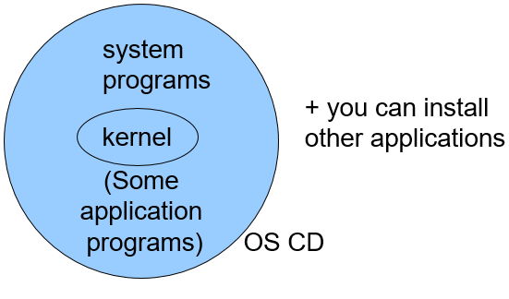
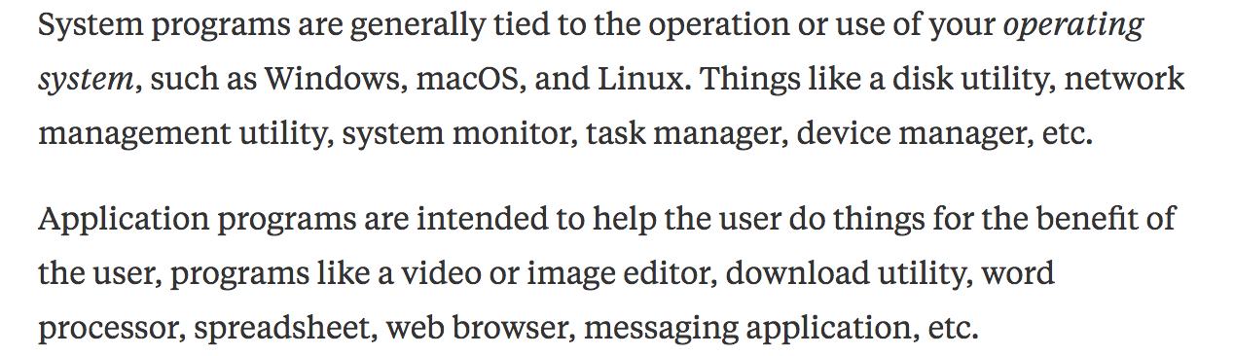
OS Definition
<number> / 23
Kernel: to be studied in this course!
  The one program running at all times on the computer.

Slide 17
Computer Startup
<number> / 23
bootstrap program is loaded at power-up.
  Typically stored in ROM.
  Also known as firmware.
  Initializes all aspects of the system.
  Loads OS kernel (to memory) and starts execution.

Slide 18
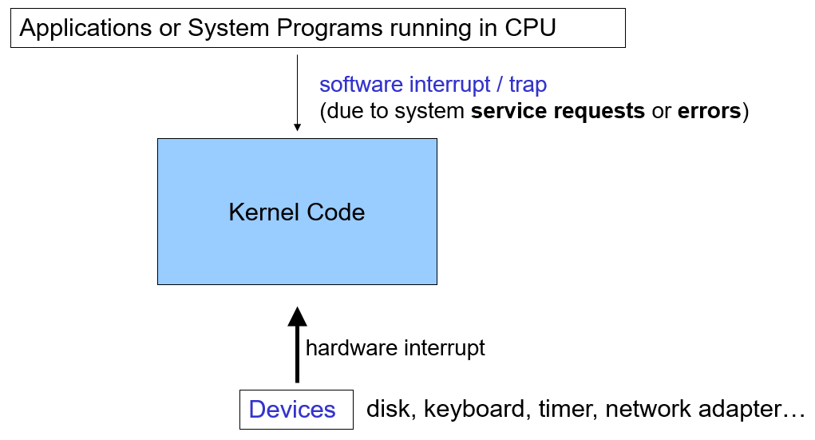
Interrupt-Driven OS
<number> / 23
CPU is either idle or used by application programs.
Then an interrupt comes and activates kernel code.

Slide 19
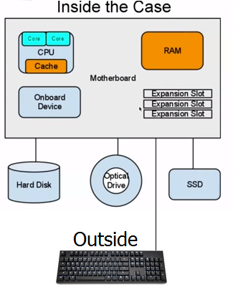
What’s really going on under the hood?
<number> / 23
a = a + 1; //C code
000000 00001 00010 00110 00000 100000 //compiled into machine code
OS knows how to feed this into the CPU, may it be AMD or Intel.
CPU performs the instruction when OS process manager permits.
OS knows how to give the CPU output to the C code (via C library).
Inside the case (Computer Architecture course):

Slide 20
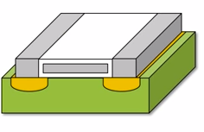
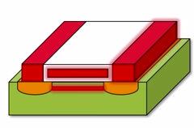
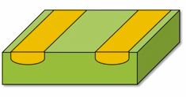
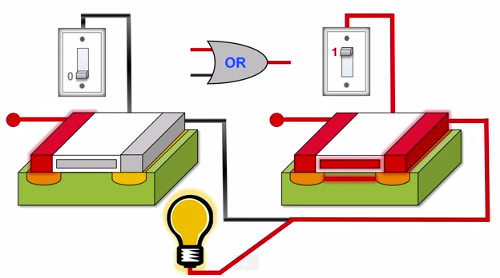
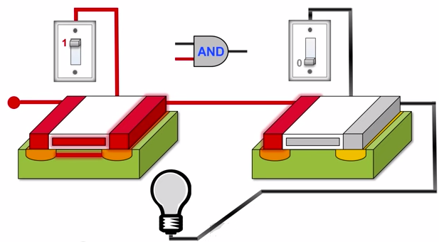
What’s really going on under the hood?
<number> / 23
Inside CPU: lots of transistors (semi-conductors).

Slide 21
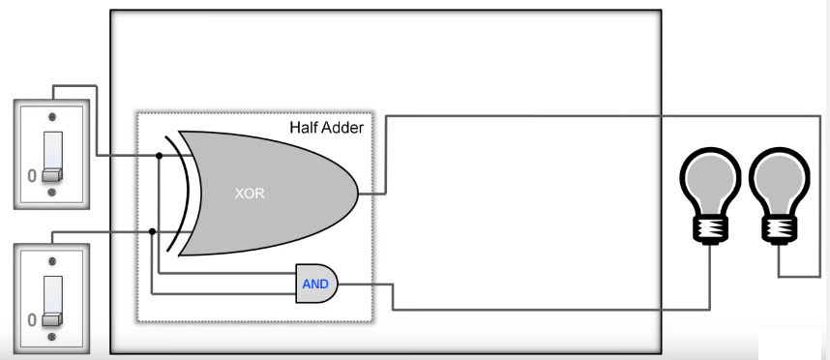
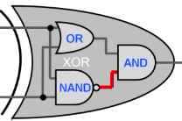
What’s really going on under the hood?
<number> / 23
Inside CPU: transistors in action; Full Adder to add binary numbers.
0110011 + 0000001 = 0110100
XOR: 1 when only 1 of the inputs is 1

Slide 22
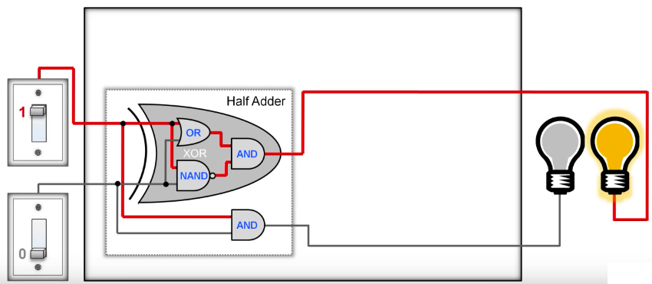
What’s really going on under the hood?
<number> / 23
Inside CPU: transistors in action; Full Adder to add binary numbers.
0110011 + 0000001 = 0110100
1 + 0 = 01 //in binary; similarly 0 + 1 = 01

Slide 23
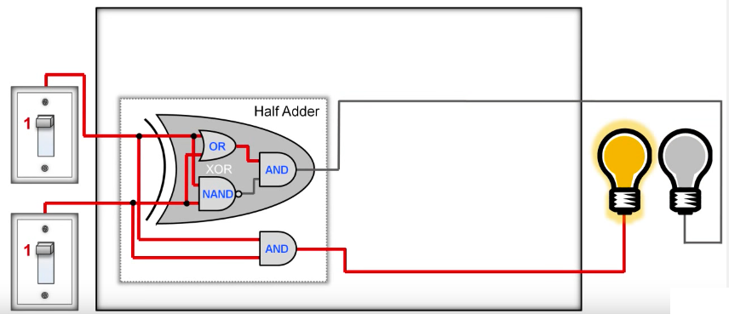
What’s really going on under the hood?
<number> / 23
Inside CPU: transistors in action; Full Adder to add binary numbers.
0110011 + 0000001 = 0110100
1 + 1 = 10 //in binary

Slide 24
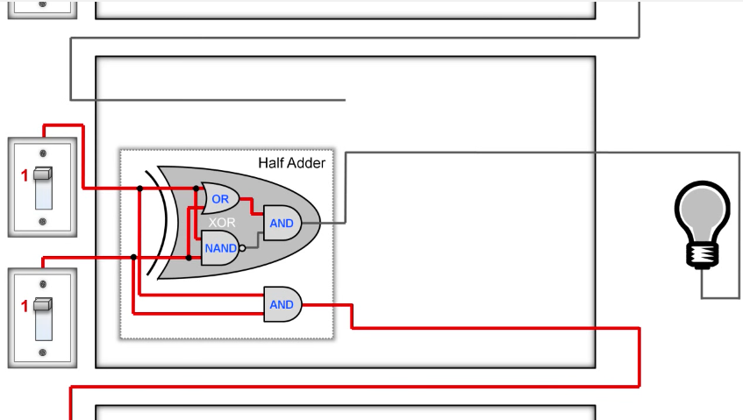
What’s really going on under the hood?
<number> / 23
Inside CPU: transistors in action; Full Adder to add binary numbers.
0110011 + 0000001 = 0110100
1 + 1 = 10 //in binary; extension: leftmost 1 must be carried out to the next full adder.

Slide 25
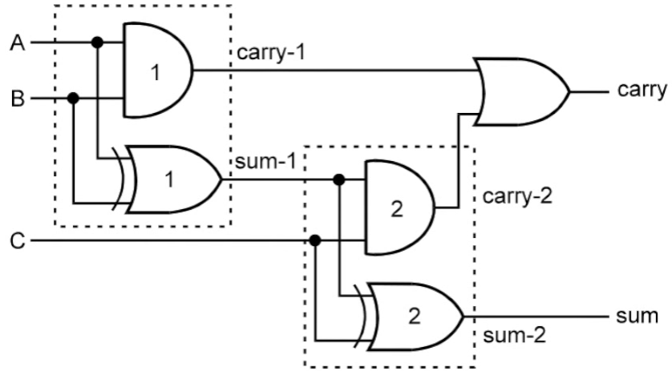
What’s really going on under the hood?
<number> / 23
Inside CPU: transistors in action; Full Adder to add binary numbers.
0110011 + 0000001 = 0110100
2 half adders make the final full adder

Slide 26
Abstraction or Arbitration?
<number> / 23
Supporting both Intel and AMD processors.
Switching between apps.
Separating memory allocated to different apps.
Enabling Skype to use different camera devices.
Accessing two different hard disks.
Notes:
Abs, Arb, Arb, Abs (Skype just has to know how to use the Camera interface that the OS provides; and then diff cameras from diff manifacturers can be used), Abs.

Slide 27

Multiple Operating Systems.
<number> / 23
Tablet devices made Unix-based OS as popular as Windows.
Embedded systems:
  Android (embedded-linux).
  iOS (based on Apple’s Mac OS).
  Blackberry OS.
  Symbian (Samsung, Nokia).
DOS/NT Unix-based (others: BSD, Solaris)
Notes:
All Windows before NT (3.1, 95, 98) were like a GUI on top of MS-DOS. After that, NT (New Technology) eliminates DOS (2000, xp, vista, 7, 8).

Slide 28
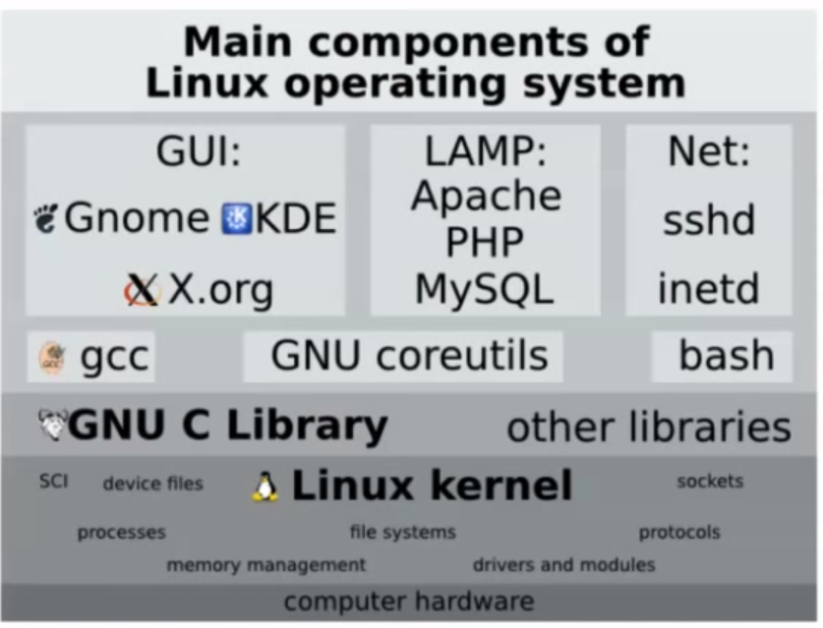
Multiple Operating Systems.
<number> / 23
Linux: same unix-based kernel, different distributions.
  Ubuntu, Debian, Red Hat, Fedora, OpenSUSE, Slackware, Gentoo, etc.
Kernel developed by undergrad Linus Torvalds (U of Helsinki, 91).
Naming: Free, freak, x → Freax vs. Linux (egostical).

